Slide 1

Software Engineering
Modeling

Slide 2
Lesson Learning Outcomes
Understand What requirements models are, and why they are useful
1
Differentiate between the uses of different types of UML diagrams
2
Learn that the UML modeling is not just for requirements
3

Slide 3

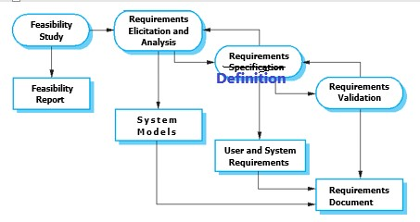
From The Previous Lecture Requirements Engineering Activities
1
2
3
4
This is also called Requirements
Specification Document RSD

Slide 4
From the previous lecture
Software Process Activities
Requirement Engineering (RE) or Requirements analysis: Establishing the system’s services, constraints, and goals.
System and software design: Allocates the require­ments to either hardware or software systems by establishing an overall system architecture.
Implementation and unit testing: The software design is real­ized as a set of programs or program units. Unit testing involves verifying that each unit meets its specifications.
Integration and system testing: The individual program units or programs are integrated and tested as a complete system to ensure that the software requirements have been met.
Operation and maintenance: The system is installed and put into practical use. Maintenance involves correcting errors and enhancing the system’s services as new requirements are discovered

Slide 5
Requirement Models
“work models help you take the next leap in understanding - from knowing the work of individual stakeholders to understanding the fundamental structure of work for a whole stakeholder population.”
– Beyer & Holtzblatt, Contextual Design
Synthesizing all the requirements you collected into key requirements. You start making diagrams that represent how requirements are related, then you have a comprehensive set of integrated requirements

Slide 6

Requirement Models
Representations of how something works
Different representations convey different useful benefits
Models are selective representations to portray an important aspect
The most important aspect [to remember] is that it [has to leave] out detail. A model is an abstraction of the system being studied rather than an alternative representation of that system An abstraction deliberately simplifies and picks out the most salient characteristics
Ian Sommerville (2011) Chapter 5, Systems Modeling

Slide 7
Important Modeling Tips
What do you want to show?
A complex decision process
A strict sequence of actions
Subtasks in a complex use case
Other software to export to, import from, or use
The structure of a system, etc.
Which diagram or model is best for this?
Avoid ‘trying to show everything in one diagram

Slide 8
CONTEXT Diagrams
Context models define the boundaries of the system
They represent key systems that need to be developed
And the relationship to the other systems/components
Also - what NOT to develop (to focus investment)

Slide 9
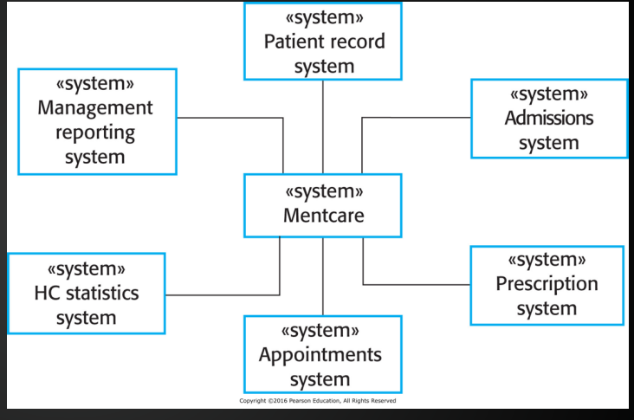
CONTEXT Diagrams

Slide 10
UML Diagrams
Different approaches used to produce models for modeling object-oriented software in software engineering
In 1990, they were ‘unified’ into a UML
UML 2 includes 13 different diagrams, each for different purposes
It is possible to automatically produce outline code from UML using Model Driven Development (MDD) approoach
https://www.uml-diagrams.org/uml-25-diagrams.html

Slide 11
UML Diagrams
Different approaches used to produce models for modeling object-oriented software in software engineering
In 1990, they were ‘unified’ into a UML
UML 2 includes 13 different diagrams, each for different purposes
It is possible to automatically produce outline code from UML using Model Driven Development (MDD) approoach
https://www.uml-diagrams.org/uml-25-diagrams.html

Slide 12
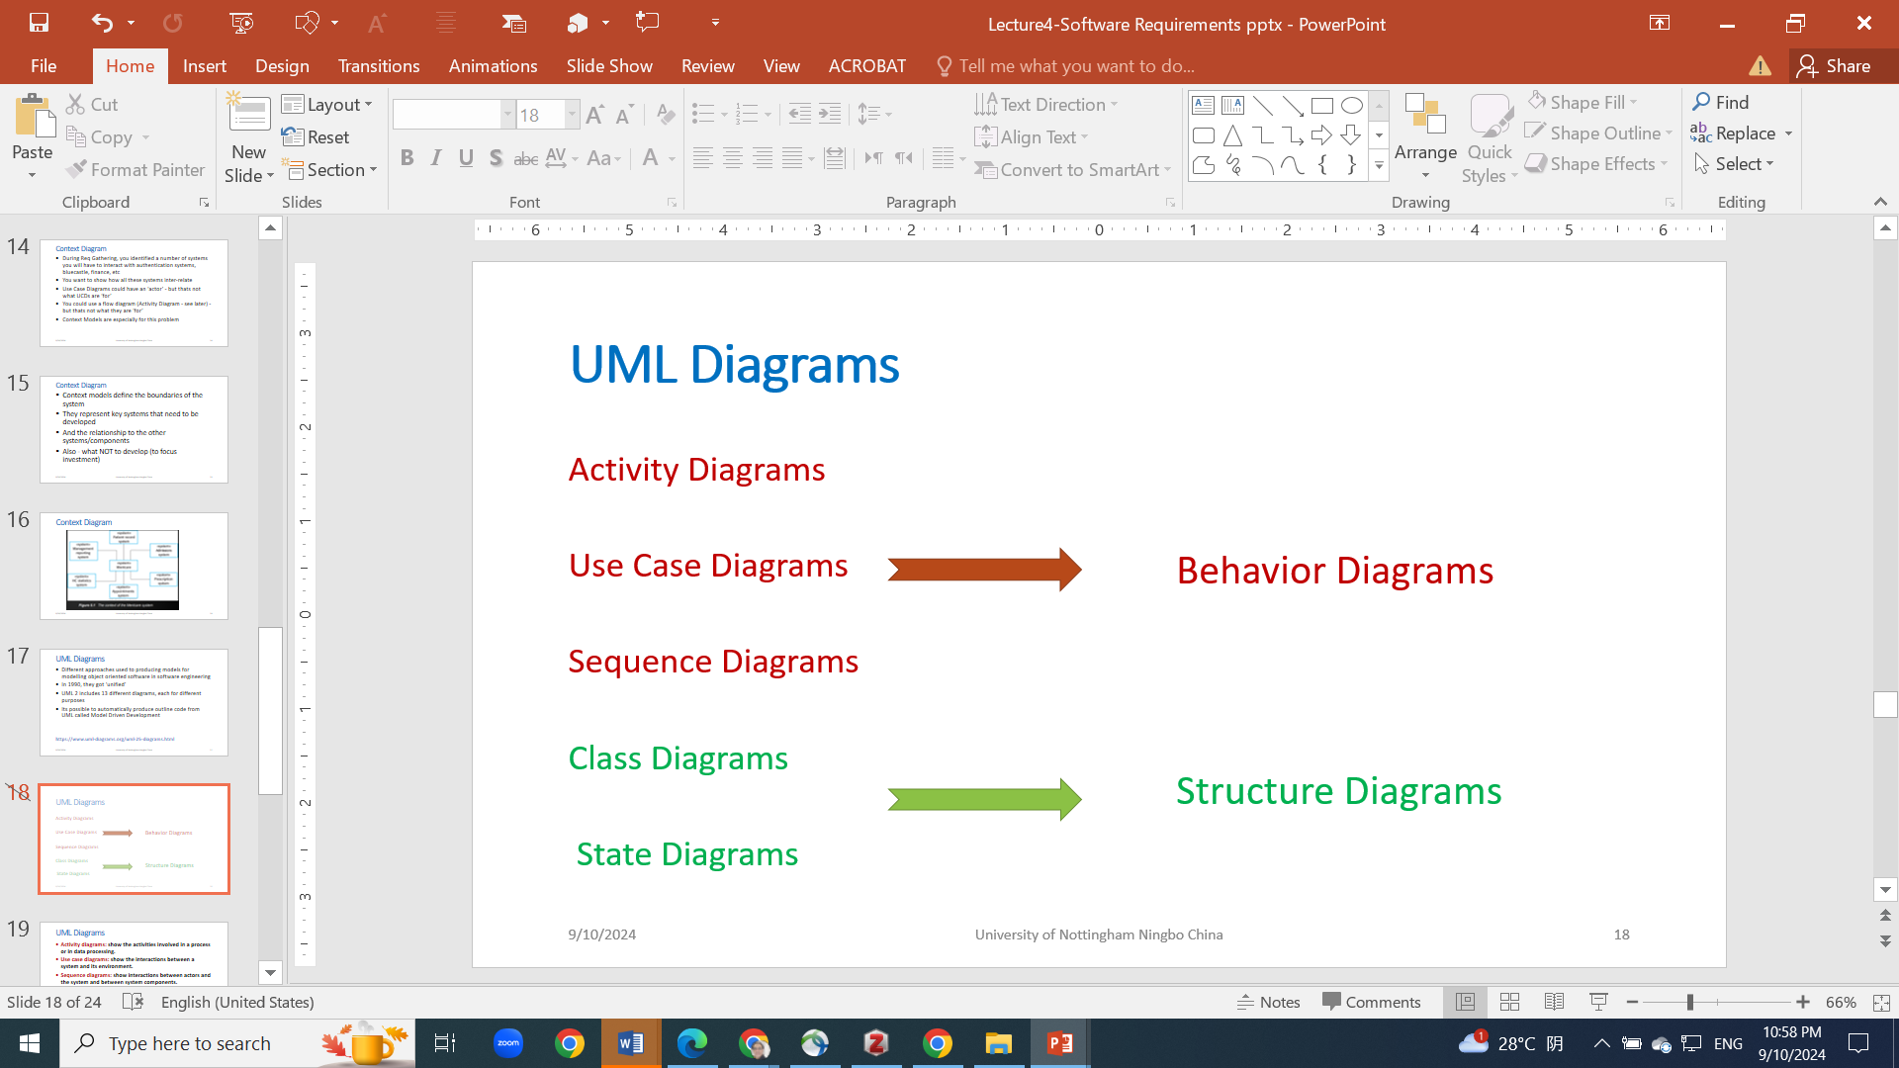
UML Diagrams

Slide 13
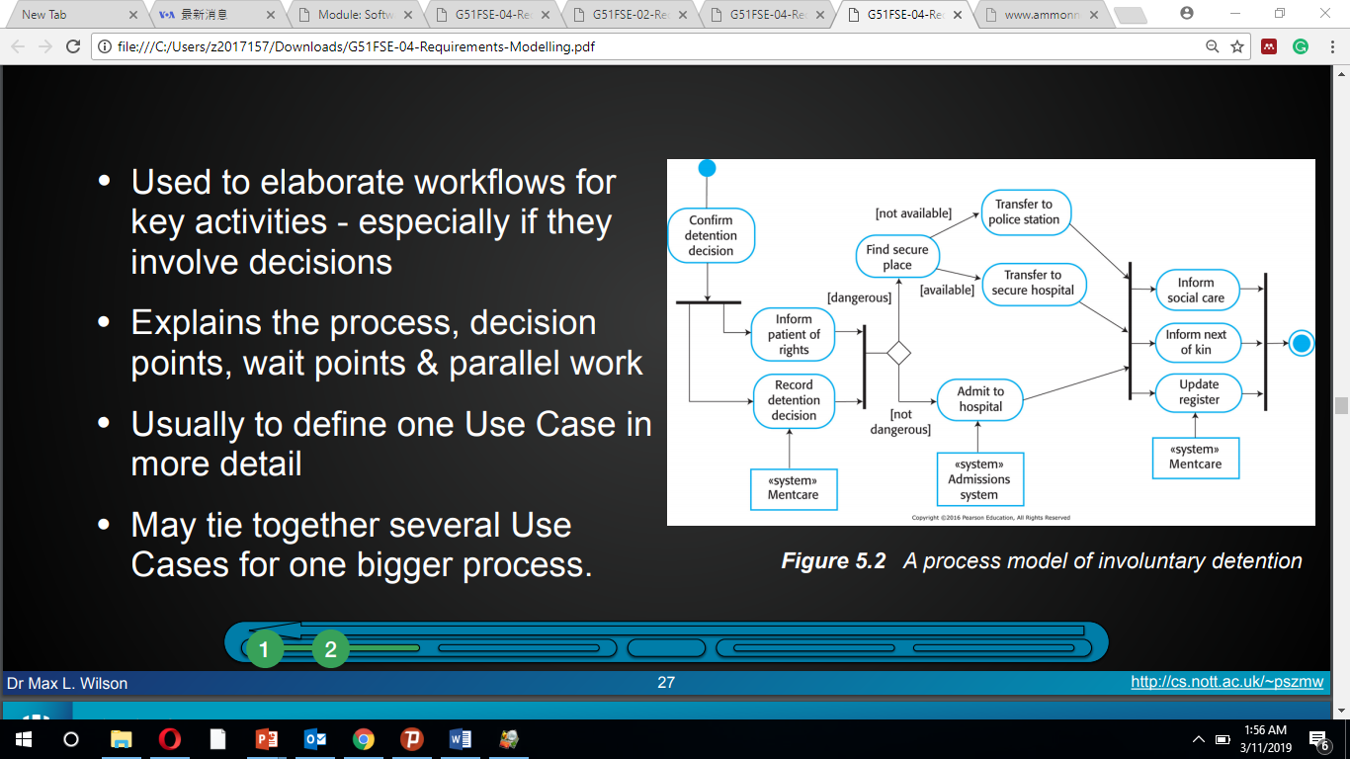
Activity Diagram
Used to elaborate workflows for key activities especially if they involve decisions
Explains the process, decision
points, wait points & parallel work
Usually to define one Use Case in more detail
May tie together several Use Cases for one bigger process.

Slide 14
Activity Diagram Notation
Rounded rectangles represent actions
Diamonds represent decisions
Bars represent the start (split) or end (join) of concurrent activities
The black circle represents the start
The encircled black circle represents the end

Slide 15

Use case diagram
Use Case Diagrams: show the set of use cases that represent all of the possible interactions in the system requirements.
Actors in the process, who may be human or other systems, are repre­sented as stick figures.
Each class of interaction is represented as a named ellipse.
Lines link the actors with the interaction.
Optionally, arrowheads may be added to lines to show how the interaction is initiated.
Each use case should be documented with a textual description
There is a tight relationship between use cases and Scenarios (discussed later)

Slide 16
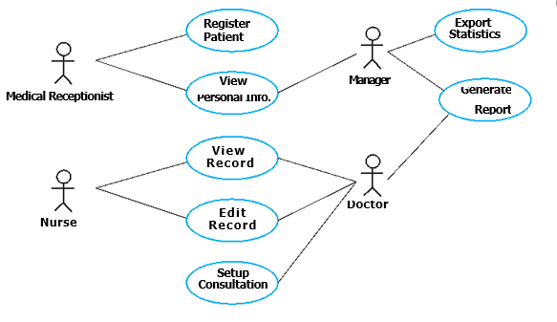
Use case diagram

Slide 17
Class Diagram
Represents the structure of a system by showing its classes, attributes, methods, and the relationships between the classes. Here’s a quick rundown of what a class diagram typically includes:
Classes: Represented as rectangles divided into three parts. The top part contains the class name, the middle part lists attributes (properties or data members), and the bottom part shows methods (functions or operations).
Relationships:
Association: A basic relationship between classes indicating that one class uses or interacts with another.
Aggregation: an association indicating a "whole-part" relationship, where one class is a part of another but can exist independently.
Composition: A stronger form of aggregation where the part cannot exist independently of the whole.
Inheritance: Depicts an "is-a" relationship where one class (the subclass) inherits attributes and methods from another class (the superclass).
Dependency: Shows that one class depends on another for its operations.

Slide 18
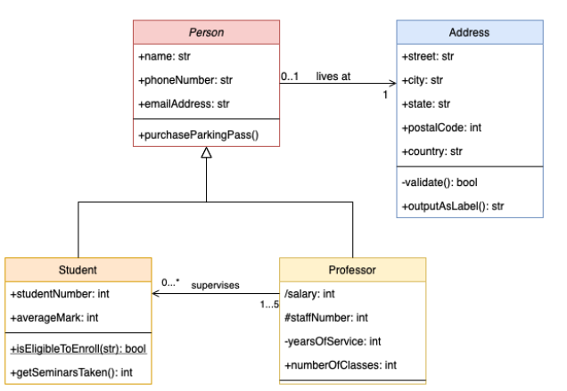
Class Diagram

Slide 19
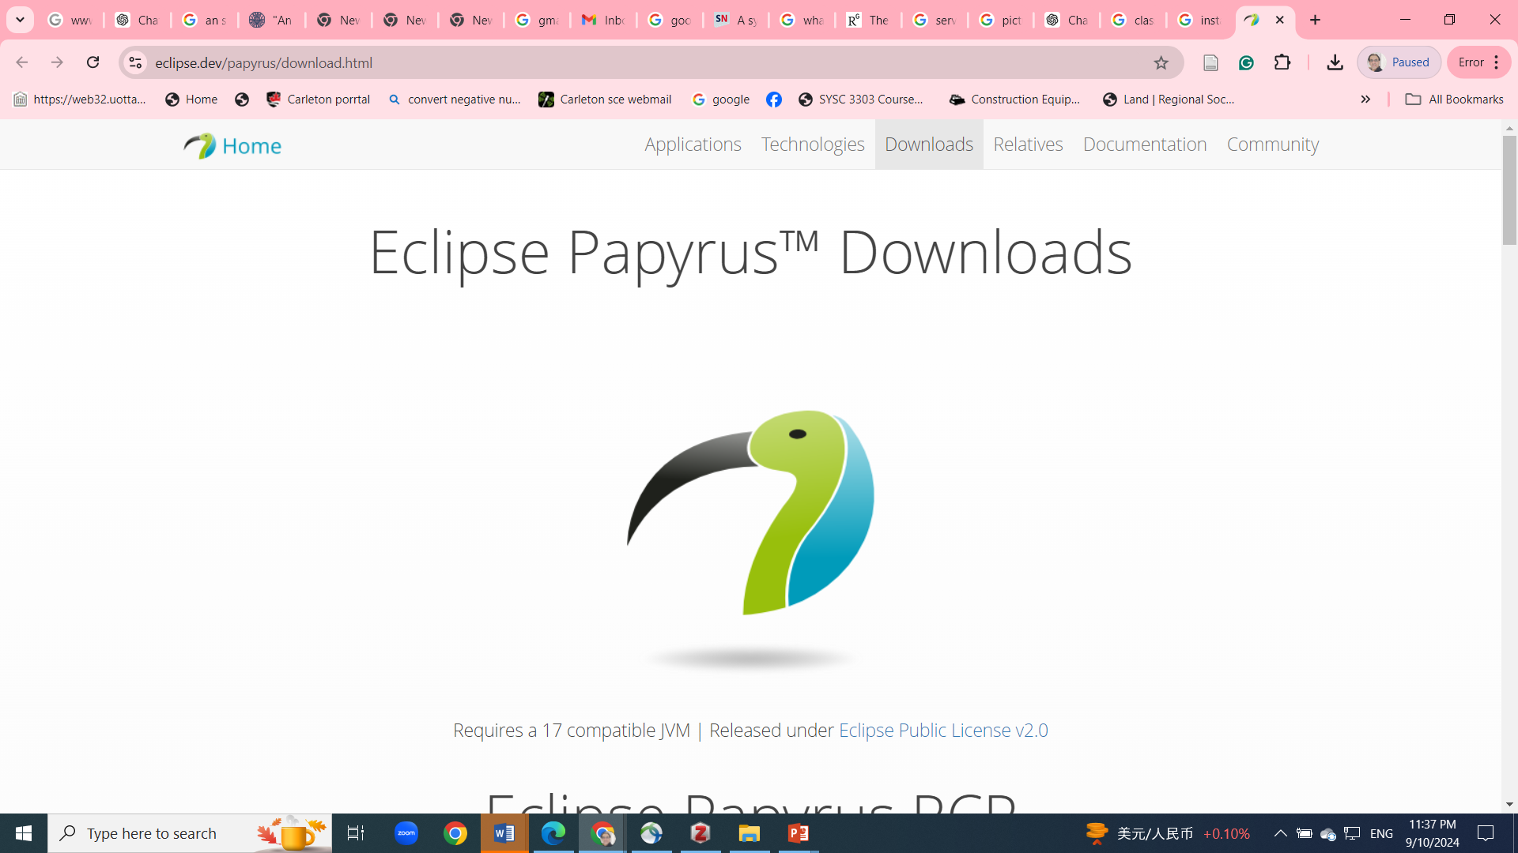
Modeling Tools
Download Eclipse Papyrus at:
https://eclipse.dev/papyrus/download.html

